Slide 1
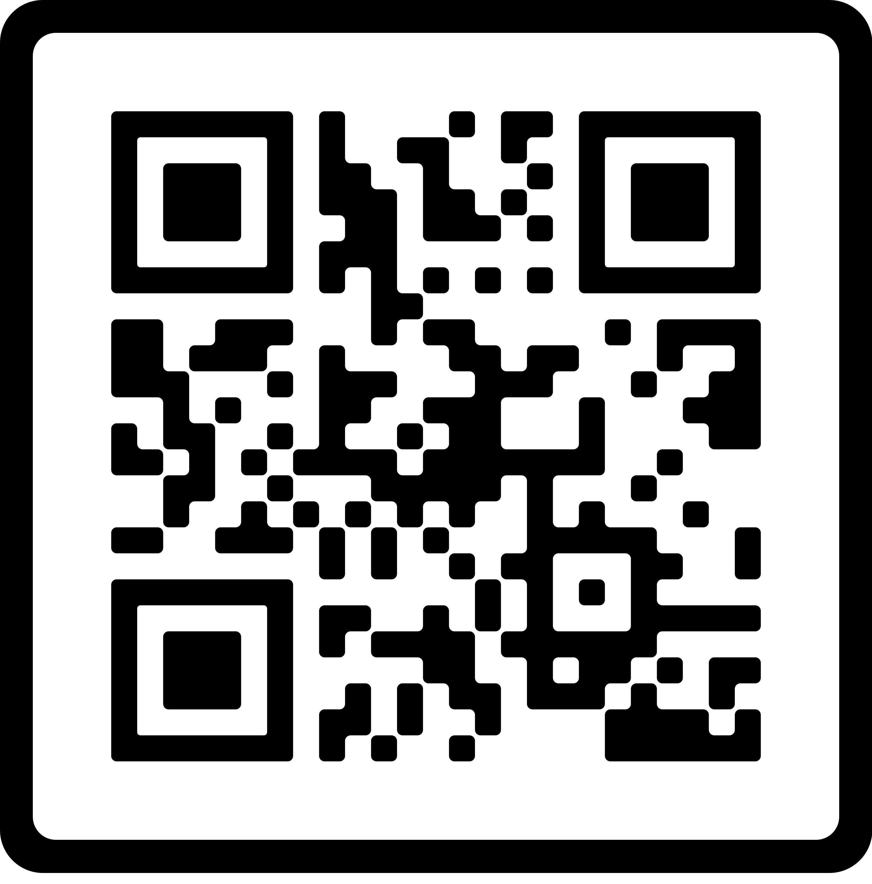
Topic: Organ Donation
Without organ donation, there is no story, no hope, no transplant. A future life is snubbed out--all its possibility, a vapor. But when there is an organ donor, life springs from death, sorrow turns to hope and a terrible loss becomes a gift.
Many faith communities support organ donation – which may be a surprise to some. Please follow the link to learn more about organ donation and see if this is the right choice for you.
Donate Life America/
Becoming an Organ Donor in IL & IN | Gift of Hope
Faith Community Health at Carle connects you and your faith community to needed healthcare and wellness support, taking a whole-person approach to health.
To learn more about bringing healthcare and wellness resources to your faith community, call (217) 902-3160 or email FaithCommunityHealth@carle.com.

